Slide 1
UNIT-1

Slide 2
UNIT-I
JAVA BASICS
History of Java
Java buzzwords
Data types
Variables
Simple java program
scope and life time of variables
Operators, expressions, control statements
Type conversion and casting
Arrays
Classes and objects – concepts of classes, objects
Constructors, methods
Access control
This keyword
Garbage collection
Overloading methods and constructors
Parameter passing
Recursion
String handling .

Slide 3
History of Java
Java started out as a research project.
Research began in 1991 as the Green Project at Sun Microsystems, Inc.
Research efforts birthed a new language, OAK. ( A tree outside of the window of James Gosling’s office at Sun).
It was developed as an embedded programming language, which would enable embedded system application.
It was not really created as web programming language.
Java is available as jdk and it is an open source s/w.

Slide 4
History of Java (contd…)
Language was created with 5 main goals:
It should be object oriented.
A single representation of a program could be executed on
multiple operating systems. (i.e. write once, run anywhere)
It should fully support network programming.
It should execute code from remote sources securely.
It should be easy to use.
Oak was renamed Java in 1994.
Now Sun Microsystems is a subsidiary of Oracle Corporation.

Slide 5

James Gosling

Slide 6
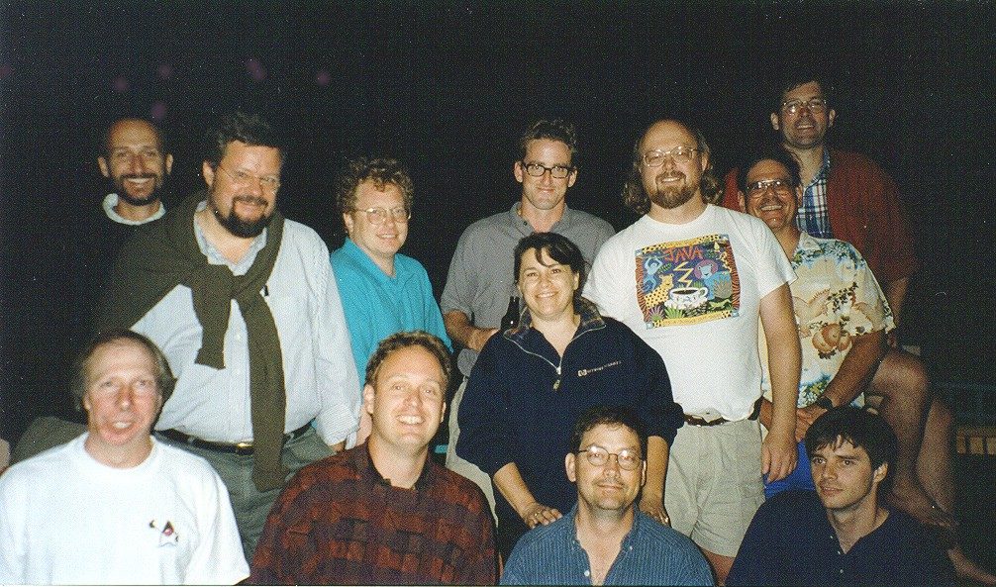
Green Team

Slide 7

Java Logo

Slide 8
Versions of Java
Version | Codename | Year | Features Added
JDK 1.0 | Oak | Jan23,1996 | -
JDK 1.1 | Rebirth of Java | Feb19,1997 | Inner classes JavaBeans, JDBC, RMI, Reflection, AWT.
J2SE 1.2 | Playground | Dec8, 1998 | JIT compiler, Collections, IDL & CORBA, strictfp, Java Plug-in.
J2SE 1.3 | Kestrel | May8, 2000 | HotSpot JVM, JavaSound, Java Naming and Directory Interface, Java Platform Debugger Architecture.
J2SE 1.4 | Merlin | Feb6, 2002 | Preferences API, Logging API, assert, image I/O API, security and cryptography extensions.
J2SE 5.0 | Tiger | Sep30, 2004 | Generics, annotations, Autoboxing, Enumerations, Varargs, Enhanced for each.
JAVA SE 6 | Mustang | Dec11, 2006 | JDBC 4.0, JVM improvements, Improved JAXB, Improved web services, Support for older Win9x versions dropped.
JAVA SE 7 | Dolphin | July28, 2011 | Major updates to Java
JAVA SE 8 | - | 2012 | -

Slide 9
Java Platforms
There are three main platforms for Java:
Java SE (Java Platform, Standard Edition) – runs on desktops and laptops.
Java ME (Java Platform, Micro Edition) – runs on mobile devices such as cell phones.
Java EE (Java Platform, Enterprise Edition) – runs on servers.

Slide 10
Java Terminology
Java Development Kit:
It contains one (or more) JRE's along with the various development tools like the Java source compilers, bundling and deployment tools, debuggers, development libraries, etc.
Java Virtual Machine:
An abstract machine architecture specified by the Java Virtual Machine Specification.
It interprets the byte code into the machine code depending upon the underlying OS and hardware combination. JVM is platform dependent. (It uses the class libraries, and other supporting files provided in JRE)

Slide 11
Java Terminology (contd…)
Java Runtime Environment:
A runtime environment which implements Java Virtual Machine, and provides all class libraries and other facilities necessary to execute Java programs. This is the software on your computer that actually runs Java programs.
JRE = JVM + Java Packages Classes (like util, math, lang, awt, swing etc) +runtime libraries.

Slide 12
Java Execution Procedure
Class Loader Byte Code Verifier
Java Class
Libraries
Java Source
Java Byte codes move locally or through n/w
Java
Interpreter
Just-in-time
Compiler
Java
Compiler
Run Time System
Java
Byte codes
Java OS
W
Win 32
Solaris
MAC
Others
Hardware

Slide 13
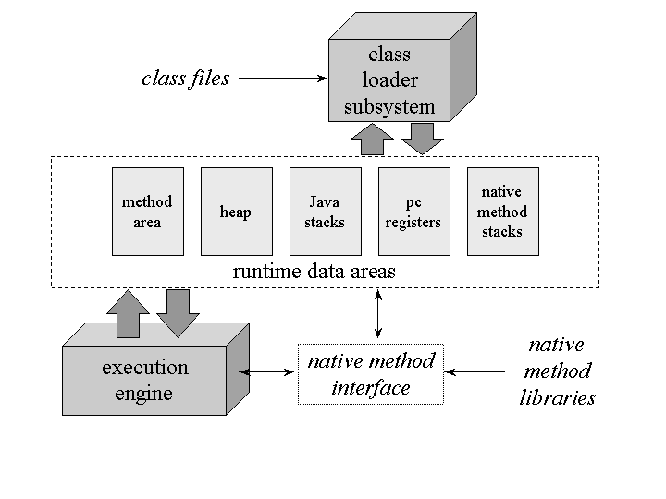
The Architecture of the Java Virtual Machine

Slide 14
Java Virtual Machine
Class loader subsystem: A mechanism for loading types (classes and interfaces) given fully qualified names.
The Java virtual machine organizes the memory it needs to execute a program into several runtime data areas.
Each Java virtual machine also has an execution engine: a mechanism responsible for executing the instructions contained in the methods of loaded classes.

Slide 15
Class loader subsystem
The Java virtual machine contains two kinds of class loaders: a bootstrap class loader and user-defined class loaders.
The bootstrap class loader is a part of the virtual machine implementation, and user-defined class loaders are part of the running Java application.
Loading: finding and importing the binary data for a type
Linking: performing verification, preparation, and (optionally) resolution
  Verification: ensuring the correctness of the imported type
  Preparation: allocating memory for class variables and initializing the memory to default values
  Resolution: transforming symbolic references from the type into direct references.
Initialization: invoking Java code that initializes class variables to their proper starting values.

Slide 16
When the virtual machine loads a class file, it parses information about a type from the binary data contained in the class file.
It places this type information into the method area.
As the program runs, the virtual machine places all objects the program instantiates onto the heap.
As each new thread comes into existence, it gets its own pc register (program counter) and Java stack.
Byte code is a highly optimized set of instructions designed to be executed by the Java run-time system, which is called the Java Virtual Machine (JVM).The JVM is an interpreter for byte code.

Slide 17
Binary form of a .class file(partial)
public class Hello
{
public static void main(String[] args)
{
System.out.println("Hello, World!");
}
}
0000: cafe babe 0000 002e 001a 0a00 0600 0c09 ................
0010: 000d 000e 0800 0f0a 0010 0011 0700 1207 ................
0020: 0013 0100 063c 696e 6974 3e01 0003 2829 .....<init>...()
0030: 5601 0004 436f 6465 0100 046d 6169 6e01 V...Code...main.
0040: 0016 285b 4c6a 6176 612f 6c61 6e67 2f53 ..([Ljava/lang/S
0050: 7472 696e 673b 2956 0c00 0700 0807 0014 tring;)V........
0060: 0c00 1500 1601 000d 4865 6c6c 6f2c 2057 ........Hello, W
0070: 6f72 6c64 2107 0017 0c00 1800 1901 0005 orld!...........
0080: 4865 6c6c 6f01 0010 6a61 7661 2f6c 616e Hello...java/lan
0090: 672f 4f62 6a65 6374 0100 106a 6176 612f g/Object...java/
00a0: 6c61 6e67 2f53 7973 7465 6d01 0003 6f75 lang/System...ou ...

Slide 18
Object Oriented Programming Concepts
Objects
Classes
Data abstraction and Encapsulation
Inheritance
Polymorphism
Dynamic Binding

Slide 19
A class is collection of objects of similar type or it is a template.
Ex: fruit mango;
Objects are instances of the type class.
The wrapping up of data and functions into a single unit ( called class) is known
as encapsulation. Data encapsulation is the most striking features of a class.
Abstraction refers to the act of representing essential features without including
the background details or explanations
Inheritance is the process by which objects of one class acquire the properties
of another class. The concept of inheritance provides the reusability.
class
object

Slide 20
Polymorphism:
It allows the single method to perform different actions based on the parameters.
Dynamic Binding: When a method is called within a program, it associated with the program at run time rather than at compile time is called dynamic binding.

Slide 21
Object-Oriented Languages Types
1.Object-based programming language: It supports
Data encapsulation
Data hiding and access mechanisms
Automatic initialization and clear-up of objects
Operator overloading
Disadvantage : They do not support inheritance and dynamic binding
Ex: Ada
2.Object-oriented programming languages:
OOP = Object-based + inheritance + dynamic binding
Ex: C++, Java, Smalltalk, Object Pascal

Slide 22
Benefits of OOP
Through inheritance, we can eliminate redundant code and extend the use of existing classes.
The principle of data hiding helps the programmer to build secure programs.
It is easy to partition the work in a project based on objects.
Object oriented system easily upgraded from small to large systems.
Software complexity can be easily managed.

Slide 23
Applications of oop
Real-time systems
Object-oriented databases
Neural networks and parallel programming
Decision support and office automation systems
CAD/CAM systems

Slide 24
What is the Difference b/w OO and OB Languages?
In Object based languages inheritance is not supported so that dynamic polymorphism also not supported.
E.g. VB,VC++.
Is C++ partial OOP?
Yes, C++ is a partial OOP because without using class also we can able to write the program.
Is Java total OOP or partial OOP?
Java is a total oop language because with out object orientation we can’t able to write any program.

Slide 25
Java is a pure oop or not ?
By default java is not pure object oriented language.
Java is called as Hybrid language.
Pure oop languages are “small talk”, ”ruby”, “Eiffel”.

Slide 26
Differences b/w C++ and Java
C++ Java
1. Global variable are 1. No Global variables.
supported. Everything must be inside
the class only.
2.Multiple inheritance 2. No direct multiple
is supported. Inheritance.

Slide 27
C++ Java
3.Constructors and 3.Java supporting constructors
Destructors supported. only & instead of destructors
garbage collection is
supported.
4.In c++ pointers are 4.No pointer arithmetic in Java.
supported.
5.C++ supporting ASCII 5. Java supports Uni code
character set. Character set.

Slide 28
Features of Java (Java Buzz Words)
Simple
Object Oriented
Compile, Interpreted and High Performance
Portable
Reliable
Secure
Multithreaded
Dynamic
Distributed
Architecture-Neutral

Slide 29
Java Features
Simple
  No pointers
  Automatic garbage collection
  Rich pre-defined class library
Object Oriented
  Focus on the data (objects) and methods manipulating the data
  All methods are associated with objects
  Potentially better code organization and reuse

Slide 30
Java Features
Compile, Interpreted and High Performance
  Java compiler generate byte-codes, not native machine code
  The compiled byte-codes are platform-independent
  Java byte codes are translated on the fly to machine readable instructions in runtime (Java Virtual Machine)
  Easy to translate directly into native machine code by using a just-in-time compiler.
Portable
  Same application runs on all platforms
  The sizes of the primitive data types are always the same
  The libraries define portable interfaces

Slide 31
Java Features
Reliable/Robust
  Extensive compile-time and runtime error checking
  No pointers but real arrays. Memory corruptions or unauthorized memory accesses are impossible
  Automatic garbage collection tracks objects usage over time
Secure
  Java’s robustness features makes java secure.
  Access restrictions are forced (private, public)

Slide 32
Java Features
Multithreaded
  It supports multithreaded programming.
  Need not wait for the application to finish one task before beginning another one.
Dynamic
  Libraries can freely add new methods and instance variables without any effect on their clients
  Interfaces promote flexibility and reusability in code by specifying a set of methods an object can perform, but leaves open how these methods should be implemented .

Slide 33
Java Features
Distributed
  Java is designed for the distributed environment of the Internet, because it handles TCP/IP protocols.
  Allows objects on two different computers to execute procedures remotely by using package called Remote Method Invocation (RMI).
Architecture-Neutral
  Goal of java designers is “write once; run anywhere, any time, forever.”

Slide 34
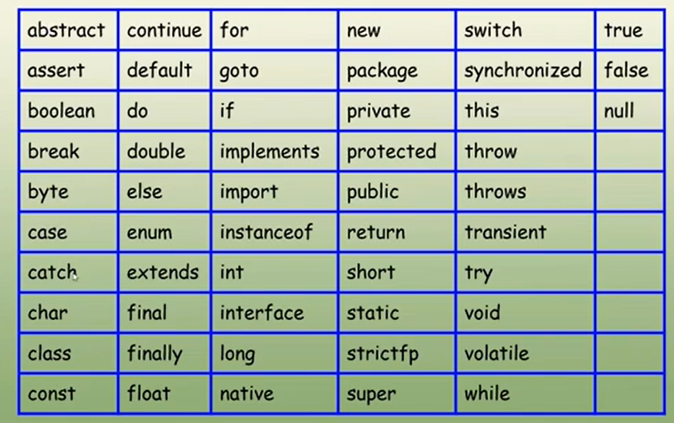
Keywords
Java has 53 reserved words, that cannot be used as variables, methods, classes, or any other identifiers
1.Keywords-50
2.Reserved Literals-3

Slide 35
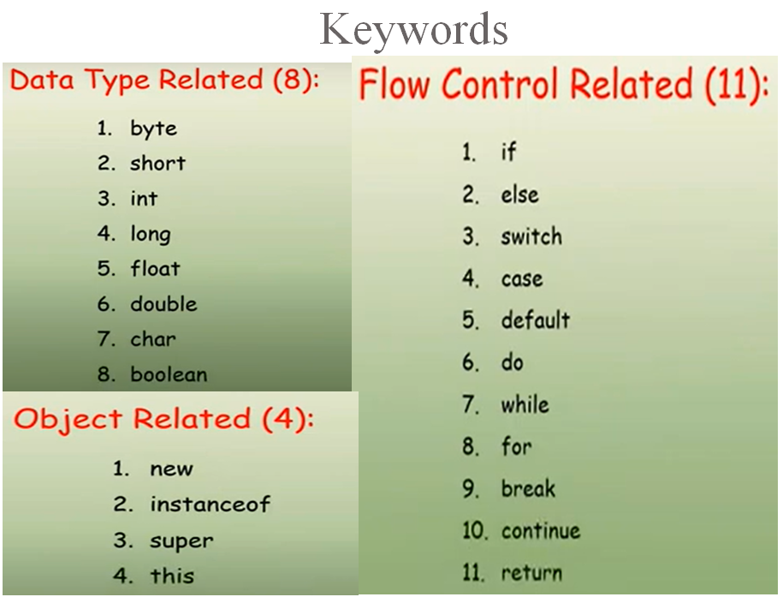

Slide 36
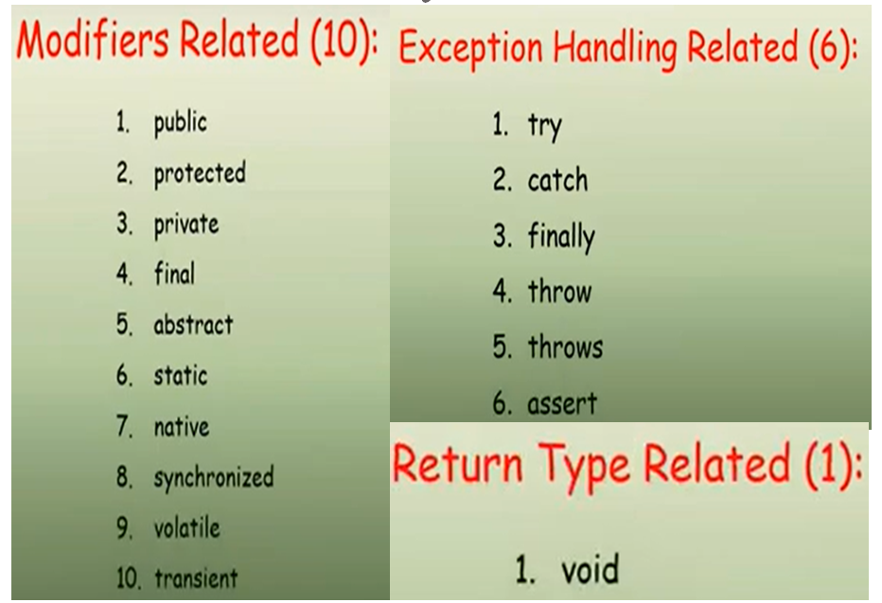
Keywords

Slide 37
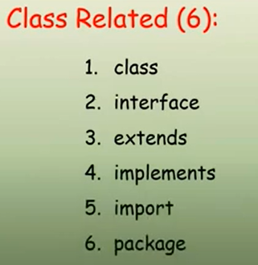
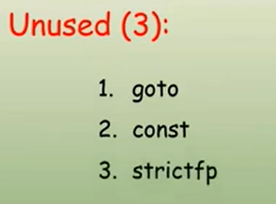
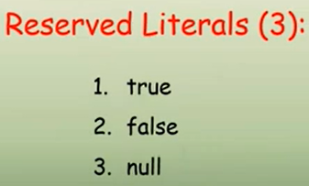
Keywords

Slide 38
Data Types
Simple Type
Derived Type
User Defined Type
E.g: Array, String…
Numeric Type
Non-Numeric
class
Interface
Integer
Float
Char
Boolean
float
double
byte
short
int
long

Slide 39
Data Types
Java Is a Strongly Typed Language
  Every variable has a type, every expression has a type, and every type is strictly defined.
  All assignments, whether explicit or via parameter passing in method calls, are checked for type compatibility.
  There are no automatic conversions of conflicting types as in some languages.
For example, in C/C++ you can assign a floating-point value to an integer. In Java, you cannot.

Slide 40
Integer Data Types
  Java does not support unsigned, positive-only integers.
  All are signed, positive and negative values.
Byte Data Type
  The smallest integer type is byte.
  Variables of type byte are especially useful while working with a stream of data from a network or file.
  Byte variables are declared by use of the byte keyword.
  Ex: byte b, c;
Floating Point Types
  There are two kinds of floating-point types.
  All math functions, such as sin( ), cos( ), and sqrt( ), return double values.
Boolean Data Type
  It can have only one of two possible values, true or false.
  This is the type, returned by all relational operators, such as a < b.

Slide 41
  Character Data Type
  char in Java is not the same as char in C or C++.
  Java uses Unicode to represent characters.
  Unicode defines a fully international character set that can represent all of the characters found in all human languages.
  It is a unification of dozens of character sets, such as Latin, Greek, Arabic, Cyrillic, Hebrew, Katakana, Hangul, and many more.
  Hence it requires 16 bits.
  The range of a char in java is 0 to 65,536.
  There are no negative chars.

Slide 42
Data Types
Name Width in bits Range
long 64 –9,223,372,036,854,775,808 to
9,223,372,036,854,775,807
int 32 –2,147,483,648 to 2,147,483,647
short 16 –32,768 to 32,767
byte 8 –128 to 127
double 64 4.9e–324 to 1.8e+308
float 32 1.4e−045 to 3.4e+038
char 16 0 to 65,536.

Slide 43
public class IntDemo{
public static void main(String args[]){
System.out.println(" For an Integer ");
System.out.println("Size is : "+Integer.SIZE);
int i1 = Integer.MAX_VALUE;
int i2 = Integer.MIN_VALUE ;
System.out.println("Max value is : "+i1);
System.out.println("Min Value is : "+i2);
System.out.println(" For an Byte");
System.out.println("Size is : "+Byte.SIZE);
byte b1 = Byte.MAX_VALUE;
byte b2 = Byte.MIN_VALUE ;
System.out.println("Max value is : "+b1);
System.out.println("Min Value is : "+b2);
System.out.println(" For an Short");
System.out.println("Size is : "+Short.SIZE);
short s1 = Short.MAX_VALUE;
short s2 = Short.MIN_VALUE ;
System.out.println("Max value is : "+s1);
System.out.println("Min Value is : "+s2);
System.out.println(" For an Long");
System.out.println("Size is : "+Long.SIZE);
long l1 = Long.MAX_VALUE;
long l2 = Long.MIN_VALUE ;
System.out.println("Max value is : "+l1);
System.out.println("Min Value is : "+l2);
}
}

Slide 44
public class FloatDemo{
public static void main(String args[]){
System.out.println(" For an Float");
System.out.println("Size is : "+Float.SIZE);
float f1 = Float.MAX_VALUE;
float f2 = Float.MIN_VALUE ;
System.out.println("Max value is : "+f1);
System.out.println("Min Value is : "+f2);
System.out.println(" For an Double");
System.out.println("Size is : "+Double.SIZE);
double d1 = Double.MAX_VALUE;
double d2 = Double.MIN_VALUE ;
System.out.println("Max value is : "+d1);
System.out.println("Min Value is : "+d2);
}
}

Slide 45
public class CharDemo{
public static void main(String args[]){
System.out.println(" For a Char");
System.out.println("Size is : "+Character.SIZE);
int f1 = Character.MAX_VALUE;
long f2 = Character.MIN_VALUE ;
System.out.println("Max value is : "+f1);
System.out.println("Min Value is : "+f2);
}
}

Slide 46
Variables
The variable is the basic unit of storage in a Java program.
A variable is defined by the combination of an identifier, a type, and an optional initializer.
Declaring a Variable
In Java, all variables must be declared before they can be used.
  type identifier [ = value][, identifier [= value] ...] ;
  Types
Instance Variable
Class Variable
Local Variable
Parameters

Slide 47
Local variables :
Local variables are declared in methods, constructors, or blocks.
Local variables are created when the method, constructor or block is entered and the variable will be destroyed once it exits the method, constructor or block.
Access modifiers cannot be used for local variables.
Local variables are visible only within the declared method, constructor or block.
There is no default value for local variables so local variables should be declared and an initial value should be assigned before the first use.

Slide 48
Instance variables :
Instance variables are declared in a class, but outside a method, constructor or any block.
Instance variables are created when an object is created with the use of the key word 'new' and destroyed when the object is destroyed.
Access modifiers can be given for instance variables.
The instance variables are visible for all methods, constructors and block in the class.
Instance variables have default values.
Instance variables can be accessed directly by calling the variable name inside the class.
However within static methods and different class ( when instance variables are given accessibility) that should be called using the fully qualified name ObjectReference.VariableName

Slide 49
Class/Static variables :
Class variables also known as static variables are declared with the static keyword in a class, but outside a method, constructor or a block.
There would only be one copy of each class variable per class, regardless of how many objects are created from it.
Static variables are stored in static memory.
Static variables are created when the program starts and destroyed when the program stops.
Visibility is similar to instance variables.
Default values are same as instance variables.
Static variables can be accessed by calling with the class name ClassName.VariableName

Slide 50
class Variables{
int i;
public int j
static long l=10;
public static float f;
char c;
boolean b;
void display(int a){
i=a;
System.out.println("i value in display: "+i);
}
public static void main(String args[]){
double d=0.0;
//public double d=0.0; invalid
Variables v1=new Variables();
Variables v2=new Variables();
Variables v3=new Variables();
v1.display(100);
v1.i=2;
v2.i=3;
v3.i=4;
System.out.println("i value is: "+v1.i);
System.out.println("i value is: "+v2.i);
System.out.println("i value is: "+v3.i);
System.out.println("i value is: "+v1.j);
v1.l=20;
v2.l=30;
v3.l=40;
System.out.println("l value is: "+v1.l);
System.out.println("l value is: "+v2.l);
System.out.println("l value is: "+v3.l);
System.out.println("f value is: "+f);
System.out.println("c value is: "+v1.c);
System.out.println("b value is: "+v1.b);
System.out.println("d value is: "+d);
}
}

Slide 51
class Variables{
int i;//instance variable
public int j ;//instance variable
static long l=10;//class variable
public static float f;//class variable
char c;//instance variable
boolean b;//instance variable
void display(int a){
i=a;
System.out.println("i value in display: "+i);
}
public static void main(String args[]){
double d=0.0;//local varible
//public double d=0.0; invalid
Variables v1=new Variables();
Variables v2=new Variables();
Variables v3=new Variables();
v1.display(100);
v1.i=2;
v2.i=3;
v3.i=4;
System.out.println("i value is: "+v1.i);
System.out.println("i value is: "+v2.i);
System.out.println("i value is: "+v3.i);
System.out.println("i value is: "+v1.j);
v1.l=20;
v2.l=30;
v3.l=40;
System.out.println("l value is: "+v1.l);
System.out.println("l value is: "+v2.l);
System.out.println("l value is: "+v3.l);
System.out.println("f value is: "+f);
System.out.println("c value is: "+v1.c);
System.out.println("b value is: "+v1.b);
System.out.println("d value is: "+d);
}
}

Slide 52
Sample Program
class HelloWorld {
public static void main (String args []) {
System.out.println (“Welcome to Java Programming…..”);
}
}
public allows the program to control the visibility of class
members. When a class member is preceded by public, then that
member may be accessed by code outside the class in which it is
declared. In this case, main ( ) must be declared as public, since it
must be called by code outside of its class when the program is
started.

Slide 53
static allows main( ) to be called without having to instantiate a
particular instance of the class. This is necessary since main ( ) is
called by the Java interpreter before any objects are made.
void states that the main method will not return any value.
main() is called when a Java application begins. In order to run
a class, the class must have a main method.
string args[] declares a parameter named args, which is an array of
String. In this case, args receives any command-line arguments
present when the program is executed.

Slide 54
System is a class which is present in java.lang package.
out is a static field present in system class which returns a
PrintStream object. As out is a static field it can call directly with
classname.
println() is a method which present in PrintStream class which
can call through the PrintStream object return by static field out
present in System class to print a line to console.

Slide 55
class sample{
public static void main(String args[]){
System.out.println("sample:main");
sample s=new sample();
s.display();
}
void display(){
System.out.println("display:main");
}
}

Slide 56
The Scope and Lifetime of Variables
Scope
The scope of a declared element is the portion of the program where the element is visible.
Lifetime
The lifetime of a declared element is the period of time during which it is alive.
The lifetime of the variable can be determined by looking at the context in which they're defined.
Java allows variables to be declared within any block.
A block begins with an opening curly brace and ends by a closing curly brace.

Slide 57
Variables declared inside a scope are not accessible to code outside.
Scopes can be nested. The outer scope encloses the inner scope.
Variables declared in the outer scope are visible to the inner scope.
Variables declared in the inner scope are not visible to the outside scope.

Slide 58
public class Scope
{
public static void main(String args[]){
int x; //know to all code within main
x=10;
if(x==10){ // starts new scope
int y=20; //Known only to this block
//x and y both known here
System.out.println("x and y: "+x+" "+y);
x=y+2;
}
// y=100; // error ! y not known here
//x is still known here
System.out.println("x is "+x);
}
}

Slide 59
Operators
Arithmetic Operators
Bitwise Operators
Relational Operators
Boolean Logical Operators

Slide 60
Arithmetic Operators(1)
Operator Result
+ Addition
– Subtraction
* Multiplication
/ Division
% Modulus

Slide 61
Arithmetic Operators(2)
Operator Result
++ Increment
+= Addition assignment
– = Subtraction assignment
*= Multiplication assignment
/= Division assignment
%= Modulus assignment
– – Decrement

Slide 62
Example:
class IncDec{
public static void main(String args[]){
int a = 1;
int b = 2;
int c,d;
c = ++b;
d = a++;
c++;
System.out.println("a = " + a);
System.out.println("b = " + b);
System.out.println("c = " + c);
System.out.println("d = " + d);
}
}

Slide 63
class OpEquals{
public static void main(String args[]){
int a = 1;
int b = 2;
int c = 3;
a += 5;
b *= 4;
c += a * b;
c %= 6;
System.out.println("a = " + a);
System.out.println("b = " + b);
System.out.println("c = " + c);
}
}

Slide 64
Bitwise Operators(1)
bitwise operators can be applied to the integer types, long, int, short, byte and char.
These operators act upon the individual bits of their operands.
Operator Result
~ Bitwise unary NOT
& Bitwise AND
| Bitwise OR
^ Bitwise exclusive OR
>> Shift right
>>> Shift right zero fill
<< Shift left

Slide 65
Bitwise Operators(2)
Operator Result
&= Bitwise AND assignment
|= Bitwise OR assignment
^= Bitwise exclusive OR assignment
>>= Shift right assignment
>>>= Shift right zero fill assignment
<<= Shift left assignment

Slide 66
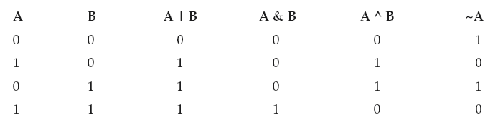
00101010 42
&00001111 15
--------------
00001010 10
00101010 42
^00001111 15
-------------
00100101 37
int a = 64;
a = a << 2; 256
int a = 32;
a = a >> 2; 8
11111000 –8
>>1
11111100 –4
11111111 11111111 11111111 11111111 –1
>>>24
00000000 00000000 00000000 11111111 255

Slide 67
Relational Operators
The relational operators determine the relationship that one operand has to the other.
They determine equality and ordering.
Operator Result
== Equal to
!= Not equal to
> Greater than
< Less than
>= Greater than or equal to
<= Less than or equal to

Slide 68
Example:
public class RelationalOperatorsDemo
{
public static void main(String args[])
{
int x=10,y=5;
System.out.println(“x>y:”+(x>y));
System.out.println(“x<y:”+(x<y));
System.out.println(“x>=y:”+(x>=y));
System.out.println(“x<=y:”+(x<=y));
System.out.println(“x==y:”+(x==y));
System.out.println(“x!=y:”+(x!=y));
}
}

Slide 69
Boolean Logical Operators(1)
The Boolean logical operators operate only on boolean operands.
All of the binary logical operators combine two boolean values to form a resultant boolean value.
Operator Result
& Logical AND
| Logical OR
^ Logical XOR (exclusive OR)
|| Short-circuit OR
&& Short-circuit AND
! Logical unary NOT

Slide 70
& //executes both left and right side operands
&& // Java will not bother to evaluate the right-hand operand when the outcome of the expression can be determined by the left operand alone.
class Test{
public static void main(String args[]){
int denom=0,num=20;
if (denom != 0 && num / denom > 10)
System.out.println("Hi");
}
}

Slide 71
Boolean Logical Operators(2)
Operator Result
&= AND assignment
|= OR assignment
^= XOR assignment
== Equal to
!= Not equal to
?: Ternary if-then-else

Slide 72
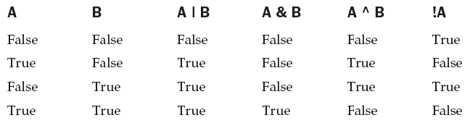

Slide 73
public class TernaryOperatorDemo
{
public static void main(String args[])
{
int x=10,y=12;
int z;
z= x > y ? x : y;
System.out.println(“Z=“+z);
}

Slide 74
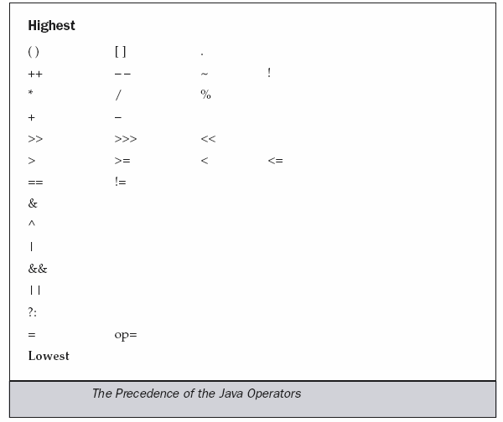
Operator Precedence

Slide 75
Expressions
An expression is a combination of constants (like 10), operators ( like +), variables(section of memory) and parentheses ( like “(” and “)” ) used to calculate a value.
Ex1: x = 1;
Ex2: y = 100 + x;
Ex3: x = (32 - y) / (x + 5)

